Slide 1
Non-standard problems in feature engineering
December 2018

Slide 2
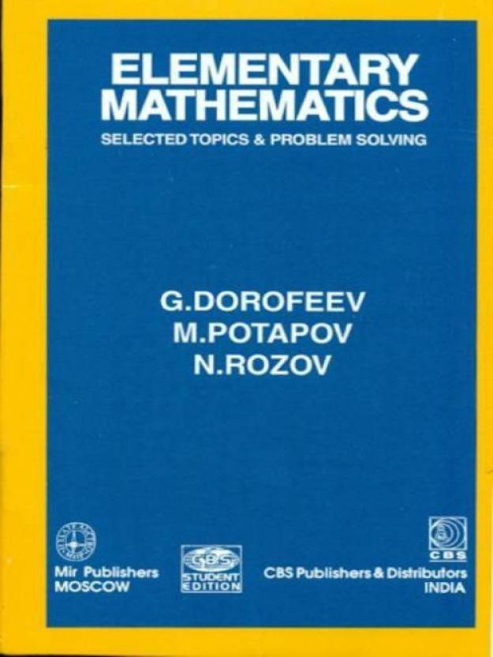
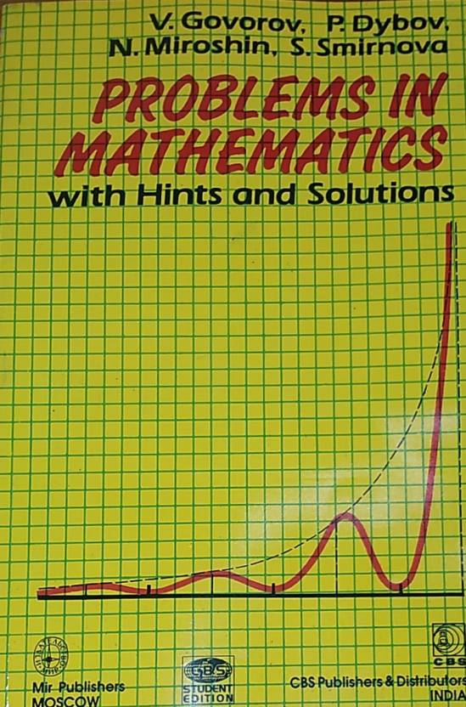
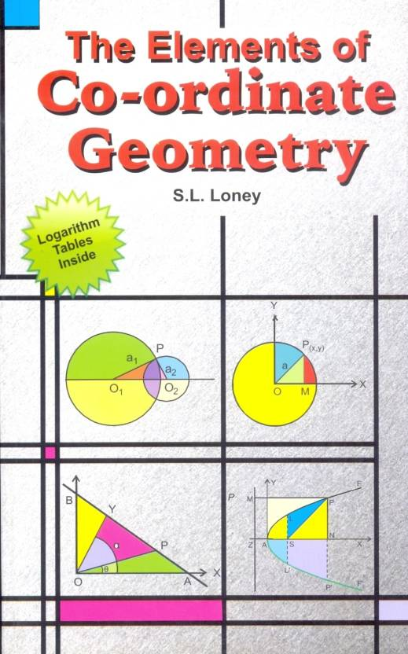
What are non-standard problems?
There are no canned solutions

Slide 3
The problems
Distributions and transformations
Missing values
Correlations

Slide 4
Problem 1

Slide 5
Problem 2

Slide 6
Problem 3

Slide 7
Thank you

